Slide 1



CO2 Emissions of the G7 Nations + Russia and China
Contents:
Overview
Discussion
Conclusion
Monica Wang, Natalie Courtney, Shahab Araghinejad, Vikremjeet Padda

Slide 2
“We have to wake up to the fierce urgency of the now”
Jim Yong Kim, President, The World Bank

Slide 3
Overview: What are we looking at? Why is it important?
While there are many GHGs, CO2 is a large contributor to climate disruption and is a byproduct of industrial economic production.
The G7 or Group of Seven refers to the top 7 industrial economies in the world. Member states include: Canada, Japan, France, Germany, Italy, the United Kingdom, and the United States.
We chose to include China and Russia in our analysis as they are two of the top industrial nations on the global stage but are not G7 nations.
Looking at this new Group of 9 or G9 we can take a look at the impact the most powerful industrial nations have on global CO2 emissions

Slide 4
Overview: Our Methodology
Our data source: 2020 Fuel Combustion IEA (International Energy Agency) report
Data starts at 1991 - the year the USSR dissolved
Report contained 169 countries → 9 relevant countries for analysis
Shahab compiled three data sets for each of the G9 nations from the report’s data for:
Overall CO2 emissions
CO2 emissions/GDP
CO2 emissions/POP

Slide 5
Let’s look at our findings!

Slide 6
Discussion
Which country produces the most CO2 and CO2/capita?
Consistently the US in both categories until 2006. Then China takes over in overall CO2 emissions.
Which country produces the least C02 and CO2/capita?
France
Which country is the median producer of C02?
Notes:
Print a table with the mean of each country for regular and CO2/capita

Slide 7
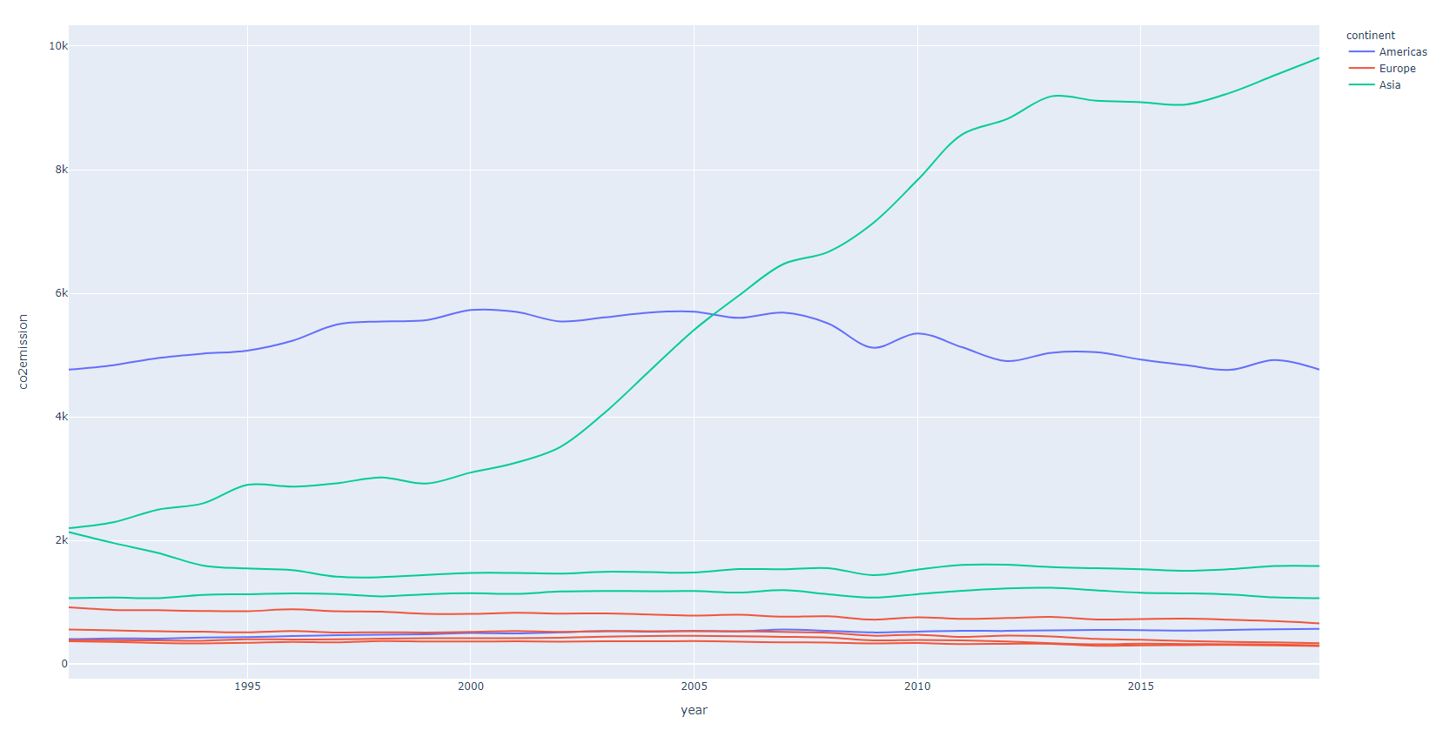
Do we see a spike in CO2 production at any point?
Have emissions dropped since the Paris Agreement (2016)?
Notes:
Line graph including each country starting in 91

Slide 8
Conclusions
The bulk of CO2 production is in the Global North.
By geographic group, Asia is the largest CO2 emitter and Europe is the smallest emitter.
There has not been a significant decrease in emissions since the Paris Agreement was signed.
While China’s overall CO2 production is the highest in the group. The US has the highest emissions per capita

